Slide 1

University of Hong Kong: Team Null Pointers
Sixth Sense: Interpretative Stock Prediction System

Slide 2







Our Team
Welvin Bun
Year 3, Computer Science
Manya Agarwal
Year 3, Computer Science
Ahsan Syed
Year 3, Computer Science
Mahnoor Ahmed
Year 3, Decision Analytics
Diabul Haque
Year 3, Computer Science
Gauri Mahendru
Year 3, Global Business & Finance

Slide 3
Current landscape of prediction models
Examining the current models
Advantages
Disadvantages
Comprehensive models
Historical insights
Predictions aren’t always right
Limited or no interpretations available
Prediction models available today take into account a large number of macro & micro factors, thereby deducing results of high accuracy
Analysing historical data to generate future predictions provides unique insights to the investor about the market’s tendencies
The markets are very unpredictable at the end of the day. Thus, it is essential that the model is understood by the investor.
Investors do not know what’s influencing the model’s output. Thus, it prevents them from efficient decision making.

Slide 4
Current landscape of prediction models
Examining the current models
Advantages
Disadvantages
Thus, we need to make the systems interpretative so that humans can apply their expertise to make the right decisions in case the prediction doesn’t seem right
Comprehensive models
Historical insights
Predictions aren’t always right
Limited or no interpretations available
Prediction models available today take into account a large number of macro & micro factors, thereby deducing results of high accuracy
Analysing historical data to generate future predictions provides unique insights to the investor about the market’s tendencies
The markets are very unpredictable at the end of the day. Thus, it is essential that the model is understood by the investor.
Investors do not know what’s influencing the model’s output. Thus, it prevents them from efficient decision making.

Slide 5
Benefits of Human Interpretable models
It’s all about the details...
?
Numbers only tell part of the story
Interpretations bring transparency
Explanatory details can be a differentiation factor
These are highly influenced by macro-economic factors, so it’s important to understand the logic behind the model for certain decision making scenarios
Transparency is essential in building trust, especially when model deployment is concerned. It also helps to investigate if the model has taken the right parameters into consideration, which in turn builds trust
Details explaining the model can help a user choose between 2 very similar models based on what fits their needs better

Slide 6
How can we provide interpretive insights for our stock price/trend prediction system to bridge the gap between academia & the industry?

Slide 7
Sixth Sense overview
Key offerings
Dashboard
Stocks
Industry
XGBoost predictions (describes impact of each factor on prediction)
Future price-line
Relevant news & prevailing sentiment
Correlation between the stock’s returns & the industry
Correlation between all stocks of an industry
Correlation between 2 selected stocks
Top 5 related stocks to a stock in the industry
Investor’s portfolio performance
Long/short recommendations
Portfolio diversification
Sixth Sense provides stock price predictions & correlation between stocks while providing interpretative features to assist the investor

Slide 8
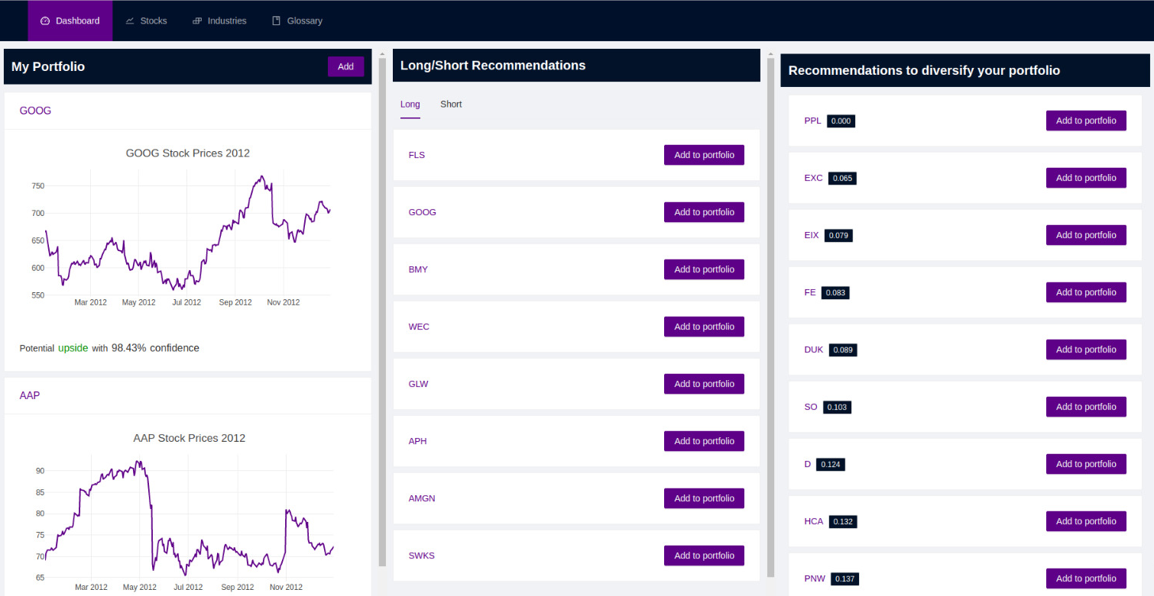
User journey
Let’s begin!
Dashboard
Stocks
Industry
On the dashboard the user can will see how his portfolio is doing
He will also be given recommendations for long/short strategies & portfolio diversification
Using the navigation bar on top, he can view search for specific stocks & industries

Slide 9

Pain-points
Wait, I don’t understand either. Is there no explanation on the website?
Looks great! Why is the future price rising though?
Lack of interpretability leads to delay in efficient decision-making
& distrust on the model

Slide 10
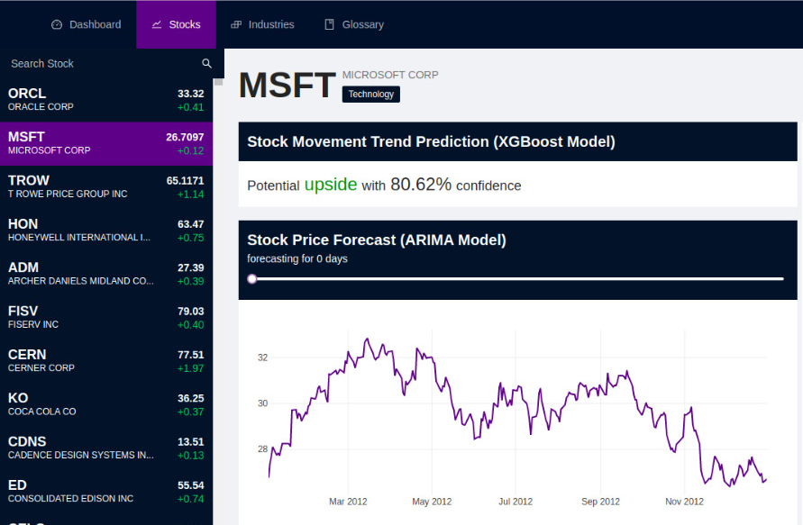
Stocks: Features
Details of the stock section
Dashboard
Stocks
Industry
After clicking on the stocks tab on the navigation bar, the user will see the following:
Predictions based on technical indicators using XGBoost
Technical indicators are created using endogenous variables that indicative of future returns
Then these indicators are processed through the XGBoost Classifier
XGBoost Classifier then predicts the movement of the future returns
1

Slide 11
Stocks: Interpretations
Explanatory details for the XGBoost model
Dashboard
Stocks
Industry
Feature importance: It shows the impact of each feature on the overall prediction
Methodology: XGBoost uses several decision trees to calculate the average information gain for the model from each feature that’s added

Slide 12
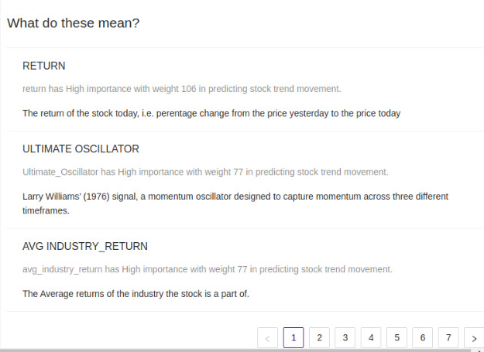
Stocks: Interpretations
Explanatory details for the XGBoost model
Dashboard
Stocks
Industry
Relevance: Describes the meaning of each factor in simple english to improve the trader’s understanding of the terminology used

Slide 13
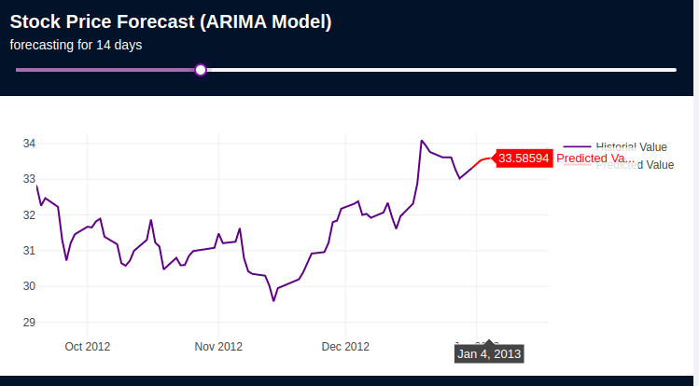
Stocks: Features
Details of the stock section
Dashboard
Stocks
Industry
ARIMA: Forecasting the future prices based on previous stock prices
Uses a linear weighted combination of previous stock prices & previous noise
2
Added utility: Visual presentation of the stock price movement

Slide 14
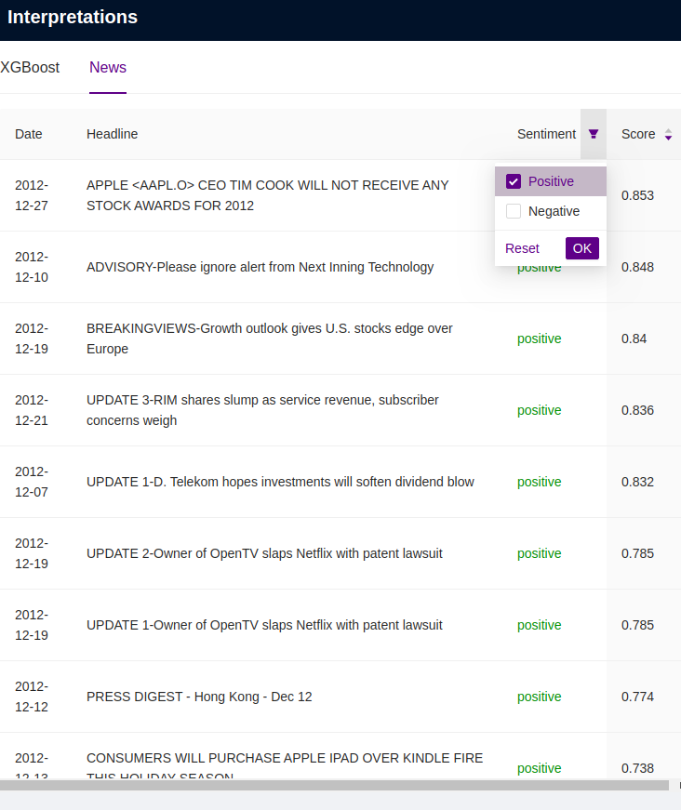
Stocks: Features
Details of the stock section
Dashboard
Stocks
Industry
Relevant news & prevailing sentiment
For each stock page, related news items to that particular stock can be seen
Sentiment scores (positive, negative or neutral) are assigned to each news article mentioned
3
Added utility: Holistic view of the prevailing market conditions & the sentiment score help improve the trader’s trust on the system

Slide 15
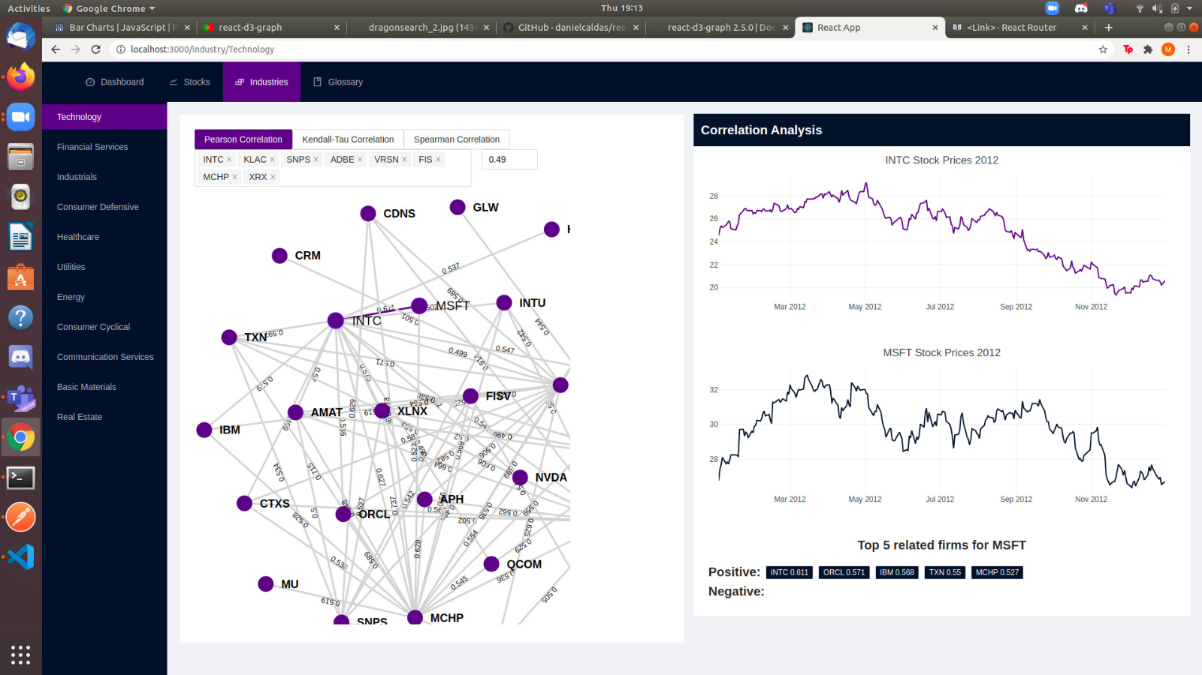
Industry: Features
Details of the Industry section
Dashboard
Stocks
Industry
Correlation between all stocks of a given industry using:
Pearson Correlation
Kendall-Tau Correlation
Spearman Correlation
1
Added utility: Allow user to select stocks and correlation value along with the type of metric they wish to use which is calculated using daily return values

Slide 16
Industry: Features
Details of the Industry section
Dashboard
Stocks
Industry
Correlation between 2 chosen stocks in an industry
2
Added utility: Closely observe the price trend of two stocks to get a better understanding of their calculated correlation value

Slide 17
Industry: Features
Details of the Industry section
Dashboard
Stocks
Industry
5 most strongly related stocks to the selected stock in that industry
3
Added utility: Gives user a quick overview of the stocks that have either a high positive or negative correlation

Slide 18
Technologies used for Sixth Sense
Softwares & libraries used to make Sixth Sense
Front-end
Back-end
React
Flask
Research
Data analysis & visualisation
Machine Learning
Interpretation libraries
NumPy
Pandas
Matplotlib
Plotly
D3
SciKit Learn
Arima
XGBoost
Keras
Shap

Slide 19
Impact
Expected benefits of using our system
Predicting function for investors to sense future stock trends
Correlation between two or all stocks in an industry
Interpretative features to assist investor in decision-making
Sixth Sense is a one-stop system to help users make investment decisions using predictions, correlational analysis & interpretative details

Slide 20
Conclusion
Our system will assist investors by providing them with insightful interpretations of the predictions shown, thereby allowing them to make decisions using the model as well as their own expertise

